Slide 1
PROJECT TITLE ONLINE BANKING SYSTEM
TEAM LEADER : SAIF ALI KHAN TEAM MEMBER: ASHWANI KUMAR
TEAM MENTOR
DR. SANGETA ARORA

Slide 2
Project overview
Online Banking allows a user to conduct financial transactions via the Internet. Online banking is also known as Internet banking or web banking. Online banking offers customers almost every service traditionally available through a local branch including deposits, transfers, and online bill payments.
USER
ADMIN
EMPLOYEE

Slide 3
Features of Online Banking
It will have Option to add, edit, view and delete all details of an employees including
Check the account statement online.
Open a fixed deposit account.
Pay utility bills such as water bill and electricity bill.
Make merchant payments.
Transfer funds.
Order for a cheque book.
Buy general insurance.
Recharge prepaid mobile/DTH.
Number of admin will be multiple who can actually manage all of the above actions.

Slide 4
Features of Employees
It will have function to check information regarding
payments quickly
Andhra Bank Net Banking
Axis Bank Net Banking
Bank of Baroda Net Banking
So, these are the basic features we would be having in our application. Now, let's get familiar with the technology we are going to use for building this application.

Slide 5

Technology used
Backend:
MySQL
For the backend side, we used the MySQL that handle the DataBase are WebSite
Frontend:
PHP, HTML & CSS
In the frontend side, we would be using PHP, HTML for Skelton of are website pages and CSS use for designing and style to are website.

Slide 6
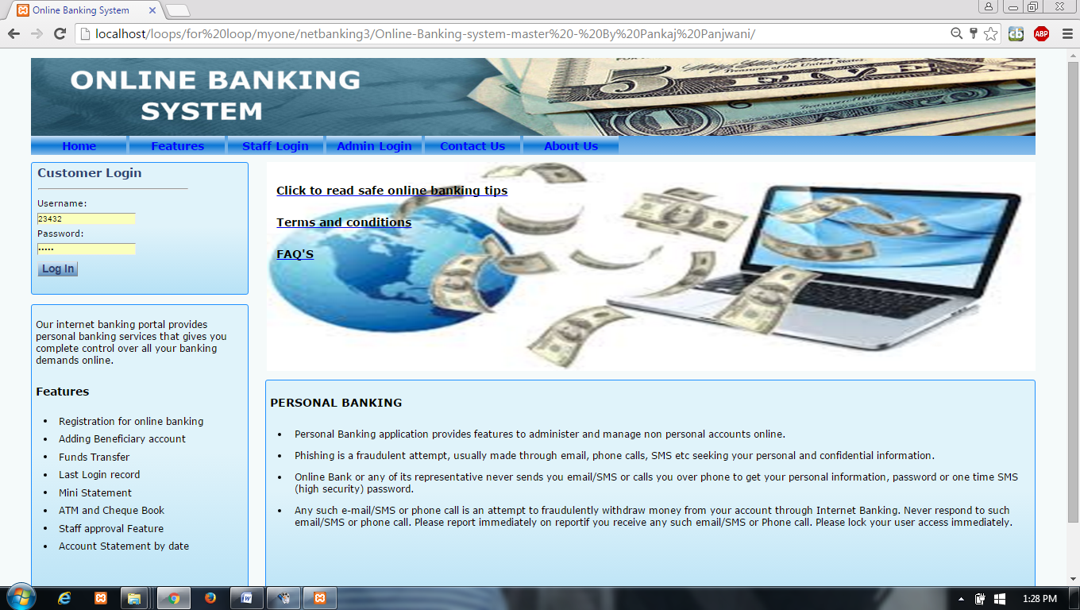
WORKING
HOME PAGE

Slide 7
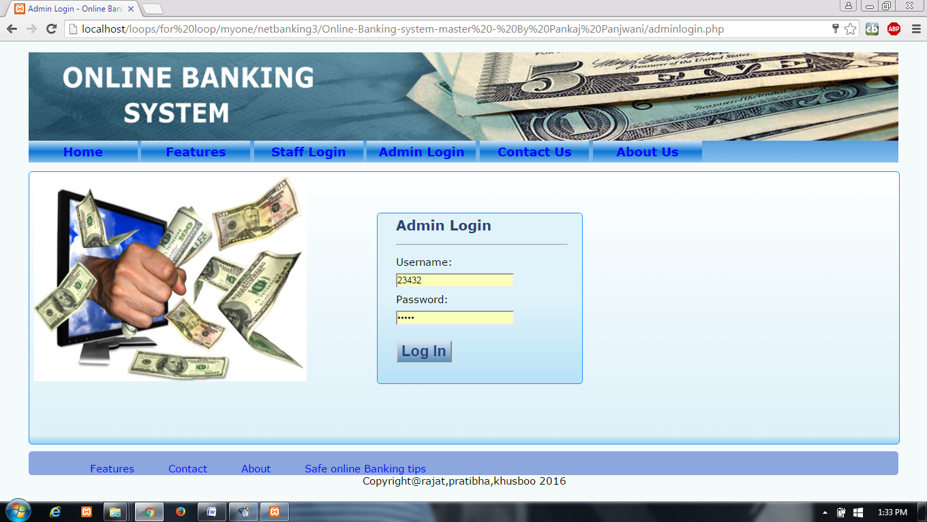
ADMIN LOGIN PAGE

Slide 8
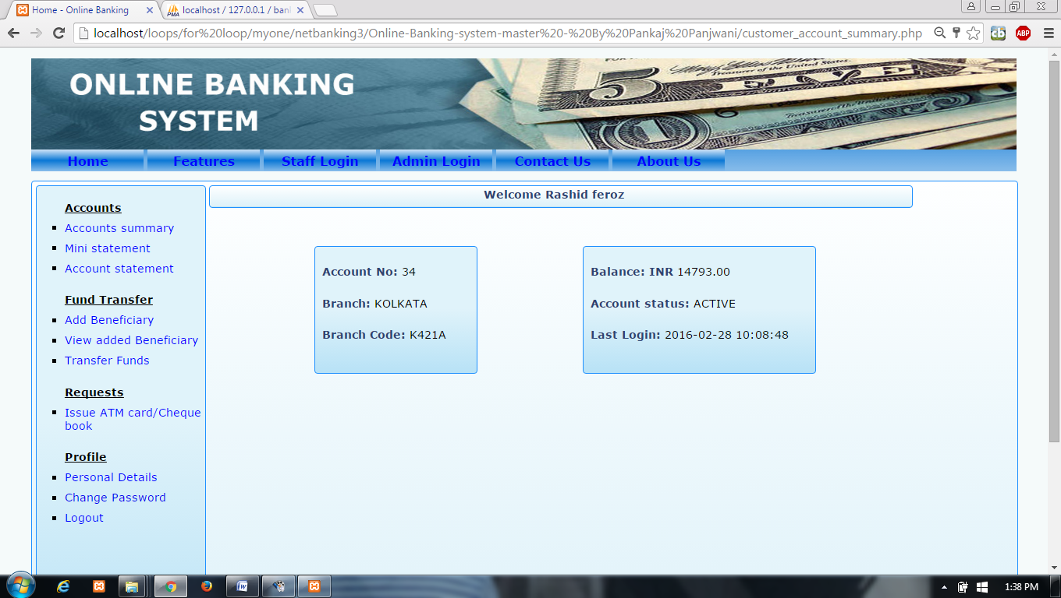
CUSTOMER HOME PAGE

Slide 9
CONCLUSION
The project entitled “Online Banking System” is developed using HTML , CSS as front end and PHP , MYSQL database in back end to computerize the process of online banking . This project covers only the basic features required.

Slide 10
Thankyou

